Slide 1
SPOTIFY CLONE
Submitted By: Team EMPIRES
Arbaazkhan R Soudagar
Akshay Jha
Noore Mujesim J
Chetana KC

Slide 2
INTRODUCTION
Spotify Clone App is a music streaming App which provide a free platform to listen music legally without downloading it .
A Spotify clone software is the secret to joining the lucrative audio listening market and obtaining an edge. a robust portal to produce millions of songs of all genres is a treat.
Spotify was reported to have a market share of 36 percent of the worldwide total of 305 million.
More than 100 million users have been on the well-known on-demand smartphone listening platforms such as Spotify for more than a decade, which has created a difference in the field of music streaming apps.
We can now make an approximate estimation of how much an app like Spotify Cost would focus on at least 520 hours of total time expected from the time of growth. Production costs would then be about $ 15-20 k

Slide 3
01
02
03
Spotify was reported to have a market share of 36 percent of the worldwide total of 305 million.
The estimated production cost of the Spotify clone software is about $ 25,000 for Android and $ 35,000 for iPhone app and $ 15,000 for websites.
It has 320 million active users including 150 million paid subscribers.

Slide 4
Pros and Cons Of Spotify!!!!

Slide 5
PROS OF SPOTIFY CLONE
1. Easy :
Everything you need to do to get started with Spotify registers for a free account.
2. Compatibility :
One of Spotify ‘s features is its higher compatibility.
3. Free Tier :
Spotify also offers a free tier which means you can use Spotify absolutely free of charge.
4. Music Collection :
You can access its vast music library of “over 40 million tracks,” whether you’re a free and Premium user of Spotify.
5. Sharing Music Experience :
Listening to Spotify can be something social.

Slide 6
CONS OF SPOTIFY CLONE
1. Lack of Lyrical Features :
Spotify removed its own feature for the lyrics.
2. Expensive :
If you switch to the paid plan, you’ll have to pay every month irrespective of whether or not you’re using the service.
3. Sound Quality :
Weak quality of sound for free users.
4. Not Available in all Countries :
Available juts within a small number of countries.
5. Ads :
Spotify users have to listen to audio advertisements between their favourite songs and podcast shows if they use the free account.

Slide 7
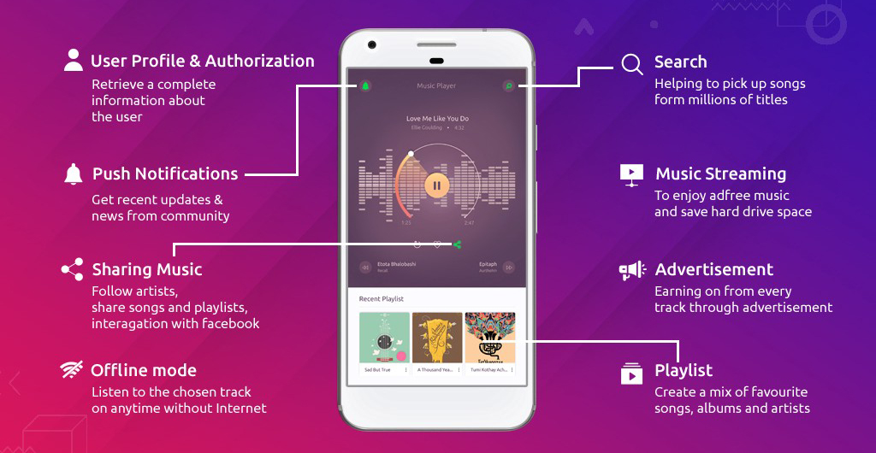
Spotify Clone Features:
1. Listen offline
2. Easy to use
3. Free subscription
4. Large music catalogue
5. Voice quality
6. View lyrics
7. Auto play
8. Shuffle play
9. Podcasts
10.Play queue & History

Slide 8
LANGUAUES
Three languages are used in spotify clone app!!!!

Slide 9
Languages used in spotify clone:
HTML
JAVA SCRIPT
CSS
HTML is being used for creating and desisning purpose of UI
JAVA SCRIPT is used for working of spotify clone app
CSS is used for designing purpose

Slide 10
HTML :
HTML stands for Hyper Text Markup Language
HTML is the standard markup language for creating Web pages
HTML describes the structure of a Web page
HTML consists of a series of elements
HTML elements tell the browser how to display the content
HTML elements label pieces of content such as "this is a heading", "this is a paragraph", "this is a link", etc.

Slide 11
JAVA SCRIPT :
JavaScript is the world's most popular programming language.
JavaScript is the programming language of the Web.
JavaScript is easy to learn.
This tutorial covers every version of JavaScript :
1. The Original JavaScript ES1 ES2 ES3 (1997-1999)
2. The First Main Revision ES5 (2009)
3. The Second Revision ES6 (2015)
4. The Yearly Additions (2016, 2017, 2018)

Slide 12
CSS :
CSS stands for Cascading Style Sheets
CSS describes how HTML elements are to be displayed on screen, paper, or in other media
CSS saves a lot of work.
CSS is the language we use to style an HTML document.
CSS describes how HTML elements should be displayed.
This tutorial will teach you CSS from basic to advanced.

Slide 13
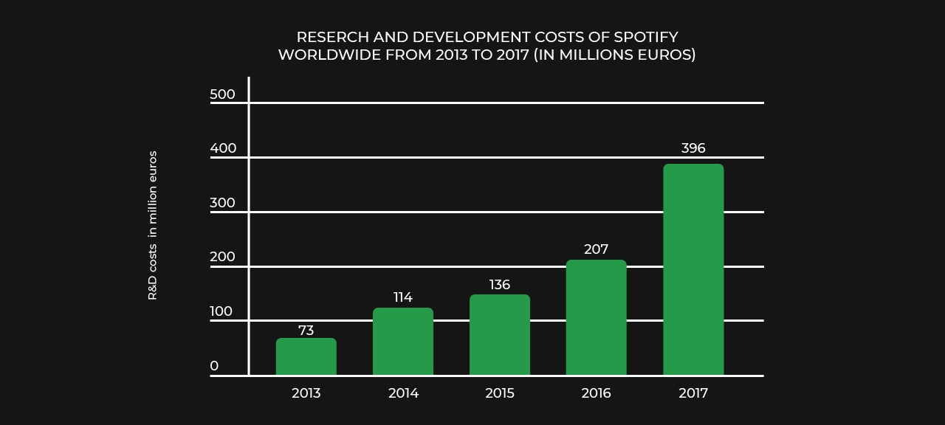
SPOTIFY EARNINGS:

Slide 14
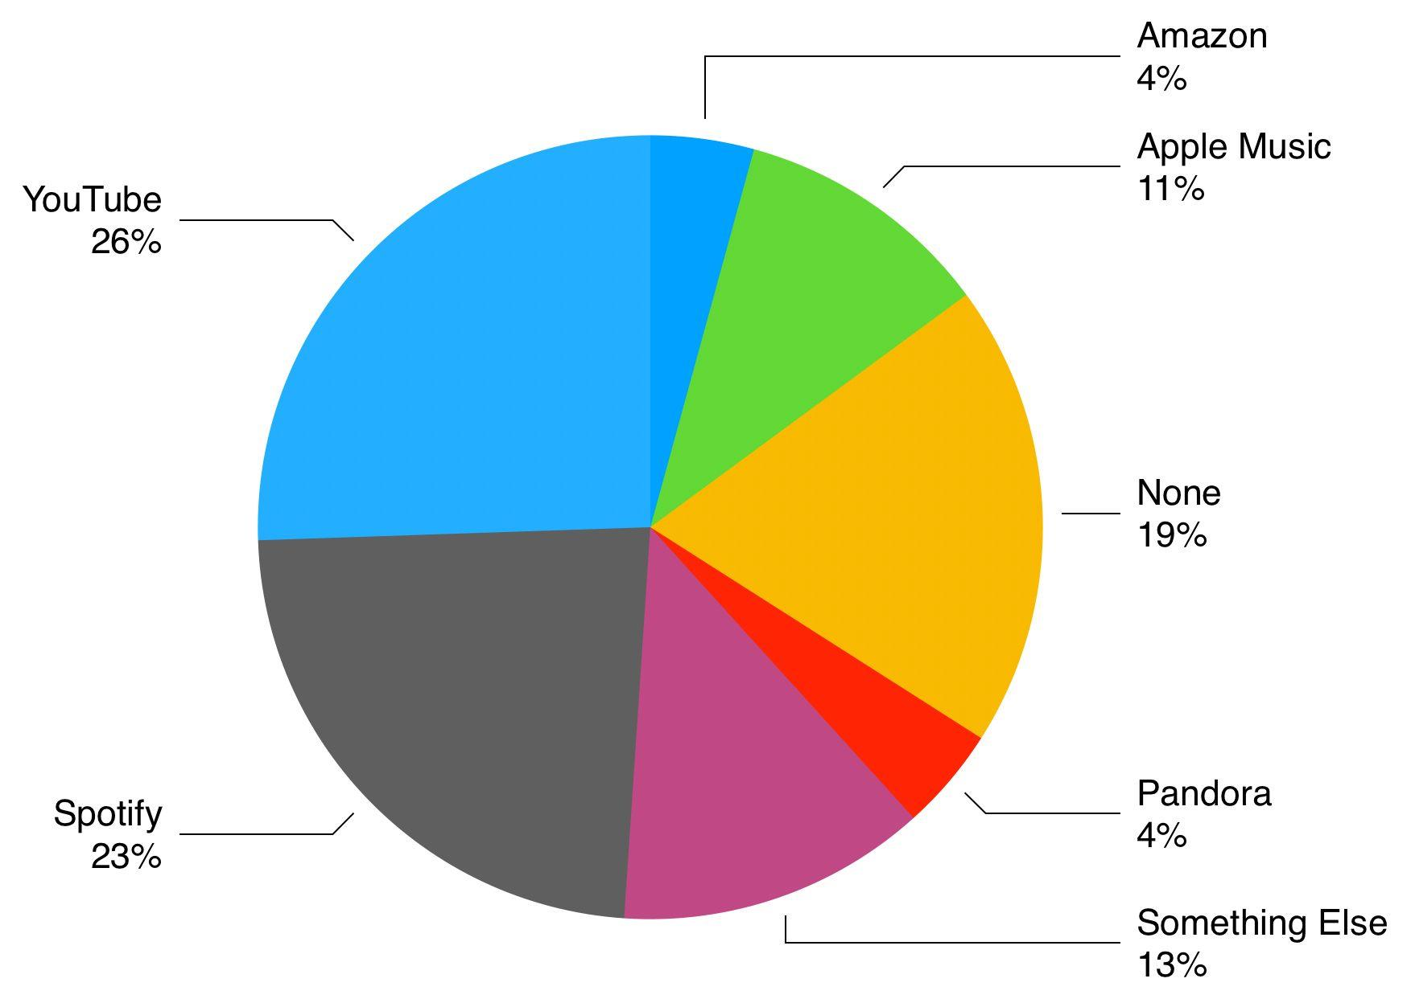
Comparison of music application development costs in detail :
Businesses or entrepreneurs located in the US spend $140-$240, not counting QA.
Western Europe-based firms or developers-$ 110-$ 170, except for QA
Eastern Europe-based business or developer-$ 120-$ 200, not including QA
India-based businesses or developers cost $ 15-30, including QA

Slide 15
A SUMMARY IS GOOD!
Spotify clone script enables users to share their favorite songs, tracks on social channels with their friends and family hassle-free.
Stream Music List:
Users can explore their favorite playlist on any of mobile platforms, i.e. Android or iOS as per their convenience
Advance Admin Panel:
Admin can manage the whole app and music streaming portal through an effective admin panel provided to them.

Slide 16
RESOURCES
https://www.m4vgear.com/spotify-music/pros-and-cons-of-spotify.html
https://belwoodmusic.com/2019/01/06/the-pros-and-cons-of-spotify/
https://www.ukeysoft.com/music/pros-and-cons-of-spotify.html

Slide 17





THANKS!
Presented By :
TEAM EMPIRES
Arbaazkhan R Soudagar
Akshay Jha
Noore Mujesim J
Chetana KC

